Slide 1


Capstone Project 1

Slide 2
Our Team
Mostafa Ahmed
Omar Abdel Razek
Haneen Mohamed
Our Facilitator:
Aya Nada

Slide 3
Project Overview and Data
This project is about taking a dataset, preprocessing it, finding key insights from it (EDA), and finally creating an interactive dashboard based on this data set
Our dataset is about Online Sales for a specific website
It contains multiple columns such as Order ID, Profit, Quantity, Category, and more…
Our data is already clean!
It doesn’t contain any duplicates or missing values

Slide 4
Project Overview and Data (cont’d)
We checked that using .duplicate().any() and .unique() function in pandas and we found no duplicates and no missing values for all columns
We had to transform some categorical columns such as Category into numerical ones in order to do some numerical analysis on it

Slide 5
Exploratory Data Analysis
Mean for our data is around 24 and the standard deviation is about 168 which is huge but it makes sense due to different categories being sold
We wanted to see if there’s a relation between the following:
Category and Profit, and we found none!
Payment method and Profit, and we found that there’s a positive correlation between payment with Credit card and Profit.
Other payment methods have no correlation
The quantity has minimum effect on the Profit as well

Slide 6
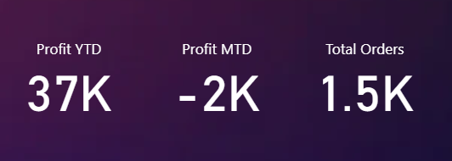
Data Visualization
First, we used a data card to show the Profit YTD, Profit MTD, and the Total Orders

Slide 7
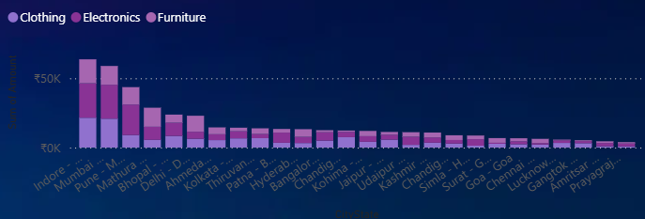
Data Visualization
Then we used a stacked column chart showing the country vs. orders amount and the categories being stacked on it

Slide 8
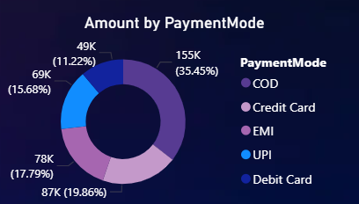
Data Visualization
Then we have a donut chart showing the payment mode along with total amount (total units)
The donut chart clearly shows percentage of each mode

Slide 9
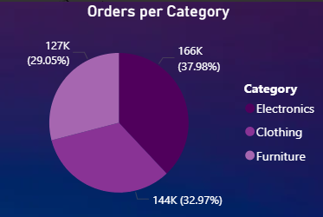
Data Visualization
Then we have Pie Chart showing orders amount vs its category, the Pie Chart shows the contribution of each category to the total amount

Slide 10
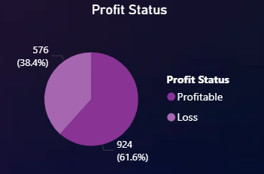
Data Visualization
Then we have Pie Chart showing the percentage of profitable orders and non-profitable ones

Slide 11
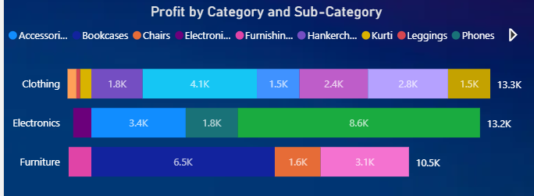
Data Visualization
Then we have the profit of each category on a bar chart stacked with the sub-category to be able to visually see the biggest and lowest profitable category

Slide 12
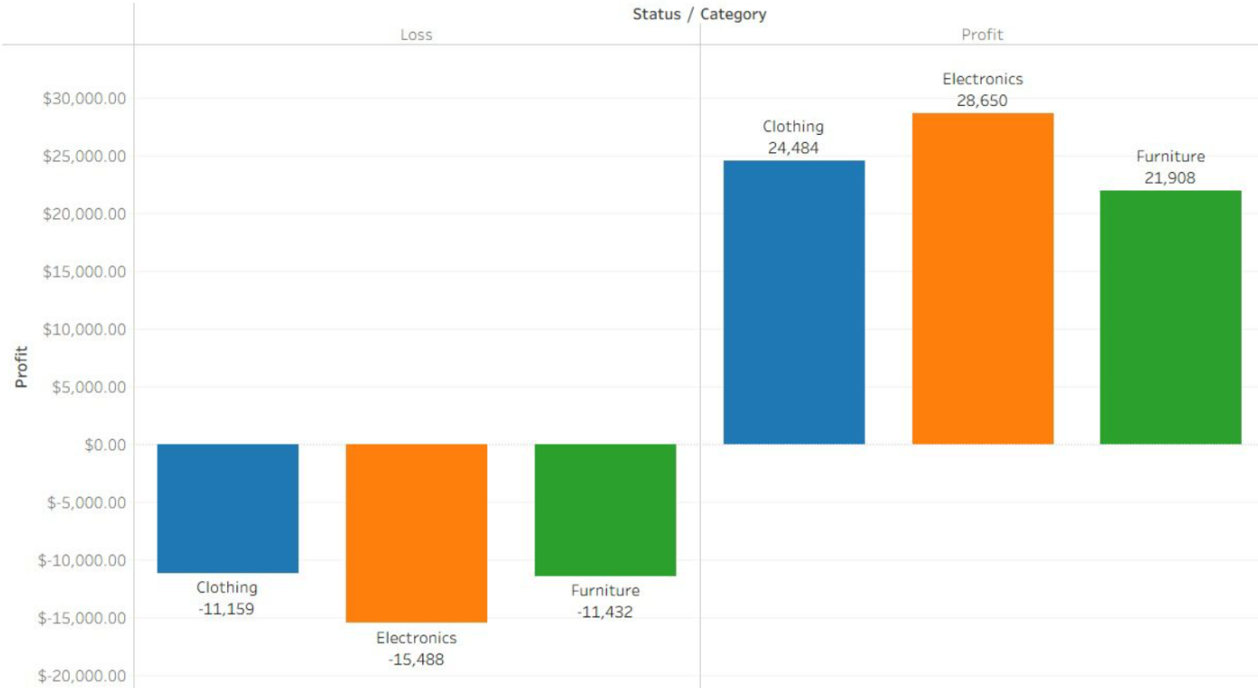
Data Visualization
And we got this bar chart from Tableau showing each category with its profit/loss

Slide 13
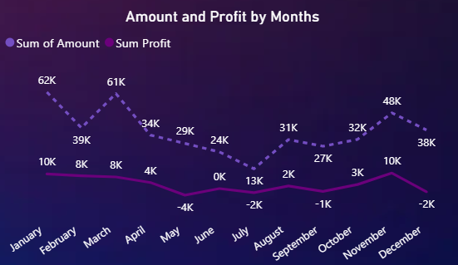
Data Visualization
And finally, we’re having the Amount and Profit vs Month, we used line chart to be able to see ups and downs clearly

Slide 14
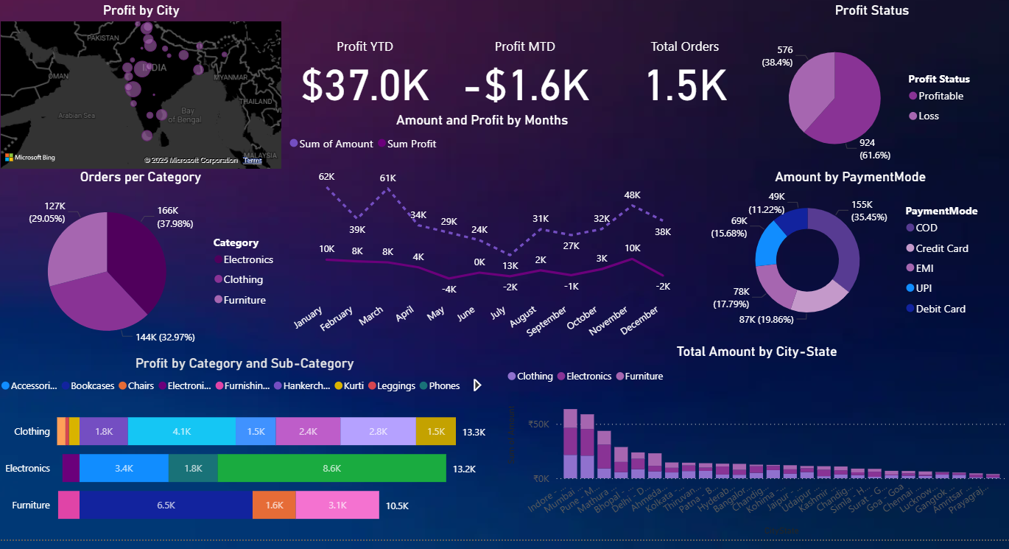
Data Visualization
The Whole Dashboard
It’s fully dynamic, we can click on a city to see the analysis for only a one and all other charts are going to change.
Equally if we specified a category to see the analysis of only a specific category, all other charts are going to change as well.
The Dashboard helps the business see insights like which cities are most contributing, which category is most profitable, what’s their profit YTD or MTD, their sales over the months, and more…

Slide 15
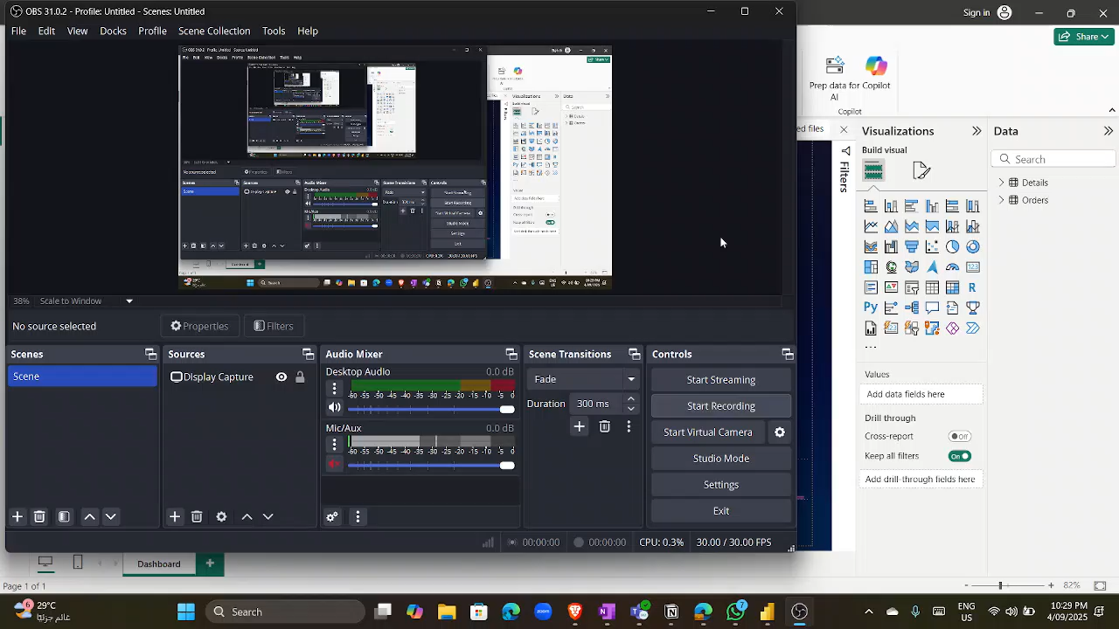
Data Visualization
Dashboard:

Slide 16
Conclusion
After doing the EDA and making the Dashboard we found the following:
Electronics and Clothes both are more profitable and being sold more than Furniture, so we can expand the variety of both, stock more of them, or use our recommendation system
January and November are the most profiting months over the year, so we might start marketing campaigns in December and October to build momentum. We can as well do discounts during these months to encourage larger purchases during these months when customers are most active.
Indore city is the one with the highest order count, so we can partner with local influencers to strengthen brand presence.

Slide 17
Conclusion (cont’d)
We also found that most used payment method is COD and we have a positive correlation between Credit Card payment mode and profit, this’s because customers fear of online fraud, failed deliveries, or lack of digital payment familiarity, so we should build trust with them and encourage using Credit Card by giving discounts
We also found that around 40% of our orders are not achieving profit, and the biggest contributor to this is the Electronics category which indicates a problem with our discount/pricing system.

Slide 18
Final Words…
Our analysis is still limited, the dataset is relatively small, it’s only one year, we don’t know much about discount applied or delivery details, so our analysis may not give the 100% correct advice.
We’re pleased to do such a project, we applied the concepts we had by practice, we learned a lot, and we’re looking for more…
Thank You!

